Slide 1

TRANS I.D. WORKSHOP
November 29th, 2023
Presented by Dana Rosamund Teagle (she/her)
Hosted by CUPE 3903 Trans Feminist Action Caucus
Slides and documentation are available for download at:
danateagle.com/trans-id-resources

Slide 2
Introduction
Hello all and thank you for joining us! I’m excited to walk you through this presentation today, and I will make sure to leave time at the end for any questions you may have.
If you would like a copy of my script, the slideshow I’ve prepared, or any of the forms & applications we discuss today, you can download them right now at danateagle.com/trans-id-resources, and they will be available at that web address for at least the next two weeks.

Slide 3
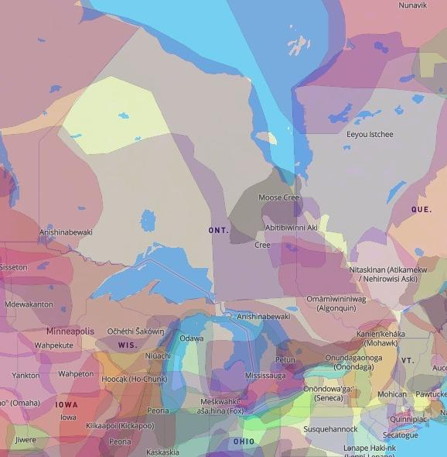
I am delivering this virtual presentation today on the traditional lands of the Haudenosaunee Confederacy, the Anishinaabeg, the Wendat, and the treaty territory of the Mississaugas of the Credit. I acknowledge them and any other Nations who care for the land as the past, present, and future caretakers of what is referred to as Tkaronto.
As part of the ongoing colonization process, there has been an attempted elimination of Two-Spirit people. I want to honour their legacy and continued significance as we have these conversations about the reality of being gender non-conforming in this country.

Slide 4
A quick background on me
I’m Dana Rosamund Teagle, and I’m a queer trans woman and software developer based in Toronto.
I’ve been doing Trans I.D. workshops for several years. My mission is to provide information and guidance for individuals looking to changing their legal name and/or gender marker in Ontario.
Previously I ran a 1-on-1 consultation service to assist folks virtually and walk them through each step. I’ve had to stop offering this service, however I am currently in the process of spearheading development on a free web app called Trans I.D. which will serve as a volunteer-moderated resource and info hub for sharing tips, tricks, services, and methods.
I am hoping to launch Trans I.D. in Ontario in early 2024, and later expand across the country. If you would like to get involved or if you would like to hear updates about the project as it progresses, you can connect with me at dana.r.teagle@gmail.com.

Slide 5
Our itinerary today
Over the next 45 minutes or so, I will give an overview of:
Ontario legal name changes
Requests for Ontario birth registrations & certificates
Sex designation changes on Ontario I.D.s
Ontario health card updates
Travel document updates
Updates to the S.I.N. registry and the C.R.A.
I will also point to resources I recommend for commissioning and notarizing, and other information and assistance for making these changes, both in Ontario and in other provinces.

Slide 6
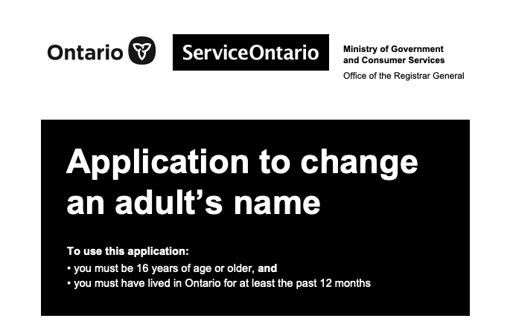
Ontario legal name changes
https://www.ontario.ca/page/change-name
You will need to fill out the Ontario Application to Change an Adult’s Name (11155E).
The application is nineteen pages long, and divided into seven parts, but you may not need to fill out all of them. You must also submit a fee of $137 with your application.
This is based on the application as of Oct 2022. Please make sure you are filling out the most recent version.

Slide 7

Requirements
Ontario legal name changes
This application requires you to fill out a lot of your personal information, including:
Full current legal name
New chosen name
Mailing address
Date and location of birth
Marital/relationship status
Parental information
Details of any previous name change
Information about any current or past criminal offences
Information about any current or past financial judgments, fines, or bankruptcy

Slide 8

Ontario legal name changes
Additional sections
- If you are married or in a joint conjugal relationship, you are required to notify your partner or spouse about your name change and must complete Part 2
- If you are 16 or 17 and changing your own name, you will require the consent of every individual who holds legal custody over you and must complete Part 3
- If you have any outstanding law enforcement orders against you, have ever been convicted of a criminal offence, or have any pending criminal charges against you, you will need a police record check as part of your application
- If you were born in another part of Canada and want a new birth certificate, you must contact the province or territory where you were born after you receive your change of name certificate

Slide 9

Ontario legal name changes
Guarantor statement
You will also require a guarantor who can prove that you have lived in Ontario for 12 months prior to your application.
In my experience, most applicants will use a medical professional for this category. However, there are several other options such as municipal clerks, school principals, and First Nations chiefs.
If you cannot find anyone that meets the requirements, you can use someone *other than a relative* who has known you for at least five years and can speak to your residency in Ontario for the past year.
Make sure you remove the Guarantor’s statement section and have the chosen individual complete and return it to you before you submit the application.

Slide 10




Previous identity documents and additional requirements
If you were born in Ontario and have a valid birth certificate, you must include the originals of all previously issued short- or long-form certificates with your application
Ontario legal name changes
If you were born outside of Ontario but within Canada, you can submit either an original birth certificate or certified copy issued by the province or territory of your birth
If you do not have a birth certificate, you will likely need to apply for a new certificate before you can submit this application
If all or part of a document sent in support of your change of name application is not written in English or French, you must send an English or French translation

Slide 11
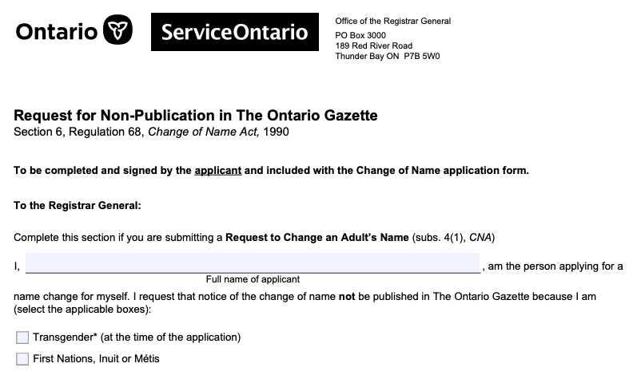
Ontario legal name changes
Request for non-publication
All name changes registered under Ontario’s Change of Name Act are generally published in The Ontario Gazette, however you can request non-publication if you are transgender, First Nations, Inuit, or Métis by submitting a completed Request for Non-Publication form with your change of name application.
They currently publish information both in paper and online, so if publication of your previous name is not desirable, I would strongly recommend adding this into your process.

Slide 12

Ontario legal name changes
Commissioning
You must sign the statutory declaration on page 16 in front of a commissioner for taking affidavits, who will seal or stamp the document at that time to verify your identity and the accuracy of the information as written. The commissioner does not have to know the person signing the application.
Several notary/commissioner’s offices in Ontario will commission these documents for trans individuals for no charge; however, the typical charge if applicable is $30-45.

Slide 13
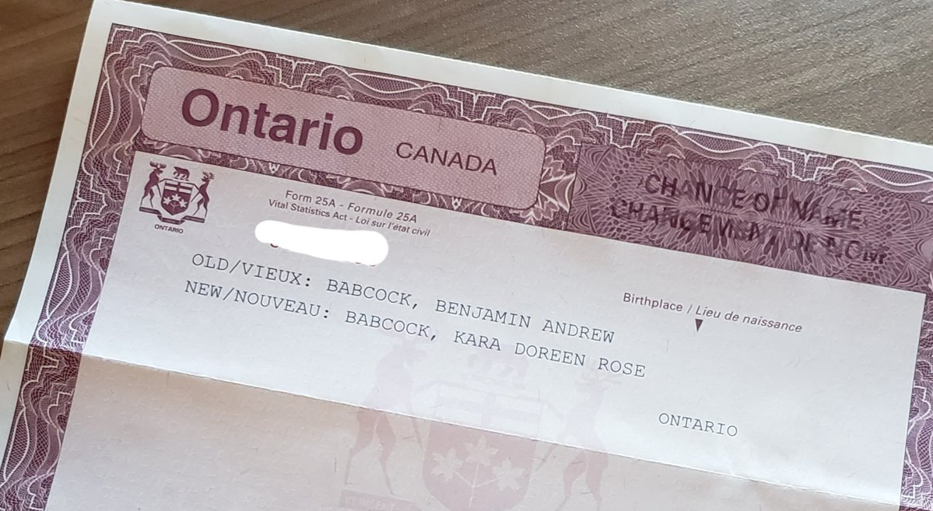
Ontario legal name changes
Submitting your application
If your application is complete and accurate, you should receive a certificate of name change in 6-8 weeks.
This document will show your previous name and your new name. You can use this certificate to change your name on other personal documents.
You can submit your application by mail to:
Or in person in Toronto at:
Office of the Registrar General
P.O. Box 3000
189 Red River Road
Thunder Bay, ON
P7B 5W0
If possible, I recommend sending the entire application in a tracked envelope using Canada Post, to ease the stress of your application getting lost in the mail, and to allow for an update when it is likely beginning to be processed.
ServiceOntario
47 Sheppard Avenue East, Unit 417, 4th Floor
Toronto, ON
M2N 5N1

Slide 14

Ontario legal name changes
Some suggestions
- Give yourself time (it will likely take several weeks to gather all the information you need, and to complete, double-check, and submit the forms)
- Print clearly using a pen with blue or black ink
- Do not use correction fluid on any forms
- If you make a mistake or want to change information, you must do the following:
- Put brackets around the wrong information
- Enter the correct information
- Put your initials beside each change
- Have the commissioner initial each change before it is sworn

Slide 15
Ontario legal name changes
Checklist
Fill out the Application to Change an Adult's Name (all relevant sections, excluding Guarantor’s Statement) and Request for Non-Publication in the Ontario Gazette (DO NOT SIGN YET)
Collect all required identification photocopies and/or original documents, including translations, if necessary
Receive consent from every person who has legal custody of you, if applicable
Give your partner/spouse notice that you are changing your name, if applicable
Receive a police check, if necessary
Secure the $137 + shipping to submit the application
Secure a guarantor and have them fill out the Guarantor’s statement
Make an appointment with a commissioner, having them witness you sign and then commission the document
Mail the document to the Office of the Registrar General in Thunder Bay, ON or submit in person in Toronto, ON

Slide 16
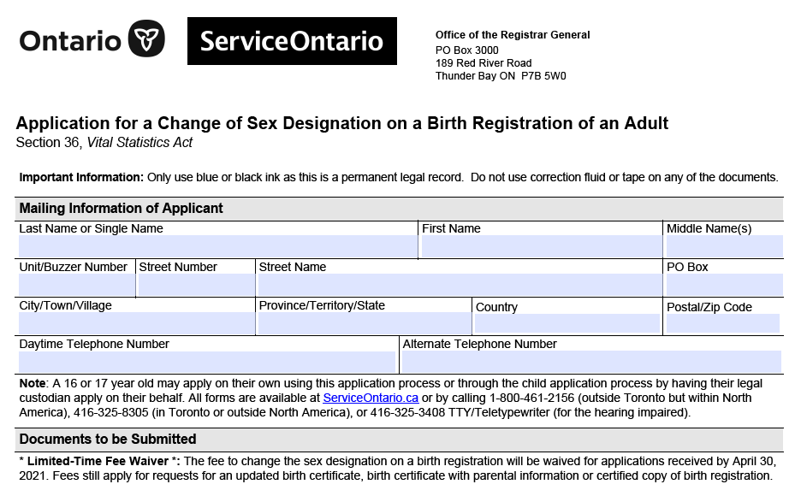
Ontario birth registrations & certificates
https://www.ontario.ca/page/changing-your-sex-designation-your-birth-registration-and-birth-certificate
To update the sex designation on your Ontario birth registration or certificate, you will need to complete the Ontario Application for Change of Sex Designation on a Birth Registration of an Adult (11325E) as well as the Statutory Declaration for a Change of Sex Designation on a Birth Registration of an Adult (11324E).
The application is two pages long, and the declaration is a single page. They can be submitted at the same time as your Ontario name change, if applicable.
This is based on the application as of Nov 2022. Please make sure you are filling out the most recent version.

Slide 17
Requirements
Ontario birth certificates
When changing your sex designation, you have the options of M (male), F (female), or X (gender neutral) or not to display the sex designation field at all. Depending on your chosen designation, your process will be different.
You must be born in Ontario, and 16 years of age or older to complete this application. Along with the forms, you must provide:
A letter from a licensed doctor or psychologist in good-standing, written on the doctor’s letterhead, stating that the doctor has examined or treated you and they can attest that the updated designation is appropriate, and signed by the doctor
All previously issued short- and long-form birth certificates and certified copies of your birth registration
A completed application form and declaration, along with any applicable fees

Slide 18
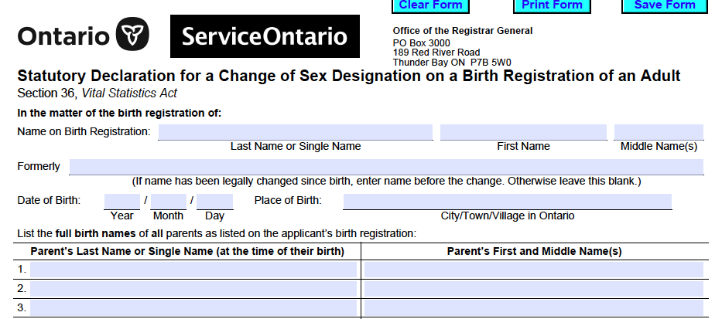
Ontario birth certificates
Commissioning
Just like the name change application, you must sign the statutory declaration of this application in front of a commissioner for taking affidavits, so please factor that into your plan as you begin to work through your documents.

Slide 19
Ontario birth certificates
Submitting your application
You can mail your application to:
Office of the Registrar General
189 Red River Road, P.O. Box 3000
Thunder Bay, Ontario
P7B 5W0
If mailing at the same time as a name change, you can mail all documents in one envelope to the address listed under that section.
If being filed without a name change, I recommend a tracked envelope as with that application. Photocopied, faxed, or e-signed documents will not be accepted.
While there used to be a fee for changing your sex designation, ServiceOntario began waiving this fee back in 2021. They have continued to periodically extend the window for free applications, and currently do not list a fee, however please make sure to double-check this policy is still in standing at the time of submission.
There also may be fees applicable for copies of short- or long-form birth certificates or registrations (unless submitting at the same time as an Ontario name change for an individual born in Ontario, which will be included in that fee).

Slide 20
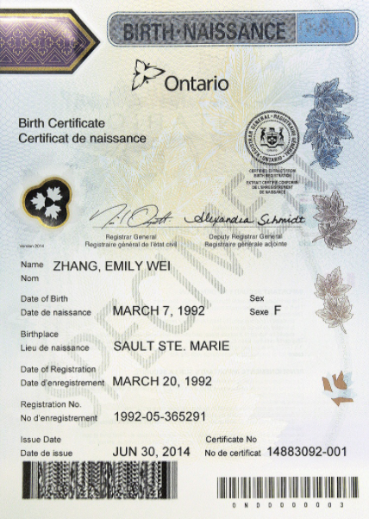
Ontario birth certificates
Important considerations
Birth certificates with a sex designation of X or no sex displayed are recognized by the Government of Ontario, who claim they do not endorse any rejection of valid Ontario birth certificates by any official body. However, unfortunately they also claim they cannot guarantee that these documents will be accepted by organizations in Ontario or in other jurisdictions.
If your application is complete and all requirements are met, you should receive your new birth certificate or registration in 6-8 weeks.

Slide 21
Driver’s licenses and photo cards
https://www.ontario.ca/page/change-sex-designation-your-government-ids
When updating the sex designation on your driver’s licence or photo card, you have the options of M (male), F (female), or X (gender neutral). Depending on your chosen designation, your process will be different.
The driver’s license changes are free for anyone with an existing license. For those who do not drive, the photo card comes with a $35 fee.
To change the sex designation on your driver’s licence to an X (gender neutral), you can simply visit a ServiceOntario. You do not require any supporting documents.
For binary sex designation changes, you can go to a ServiceOntario and bring an original document that indicates the updated sex designation. This can be your short or long-form birth certificate or a certified copy of a birth registration.

Slide 22
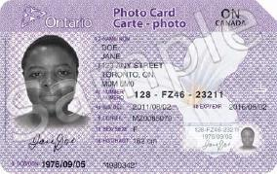
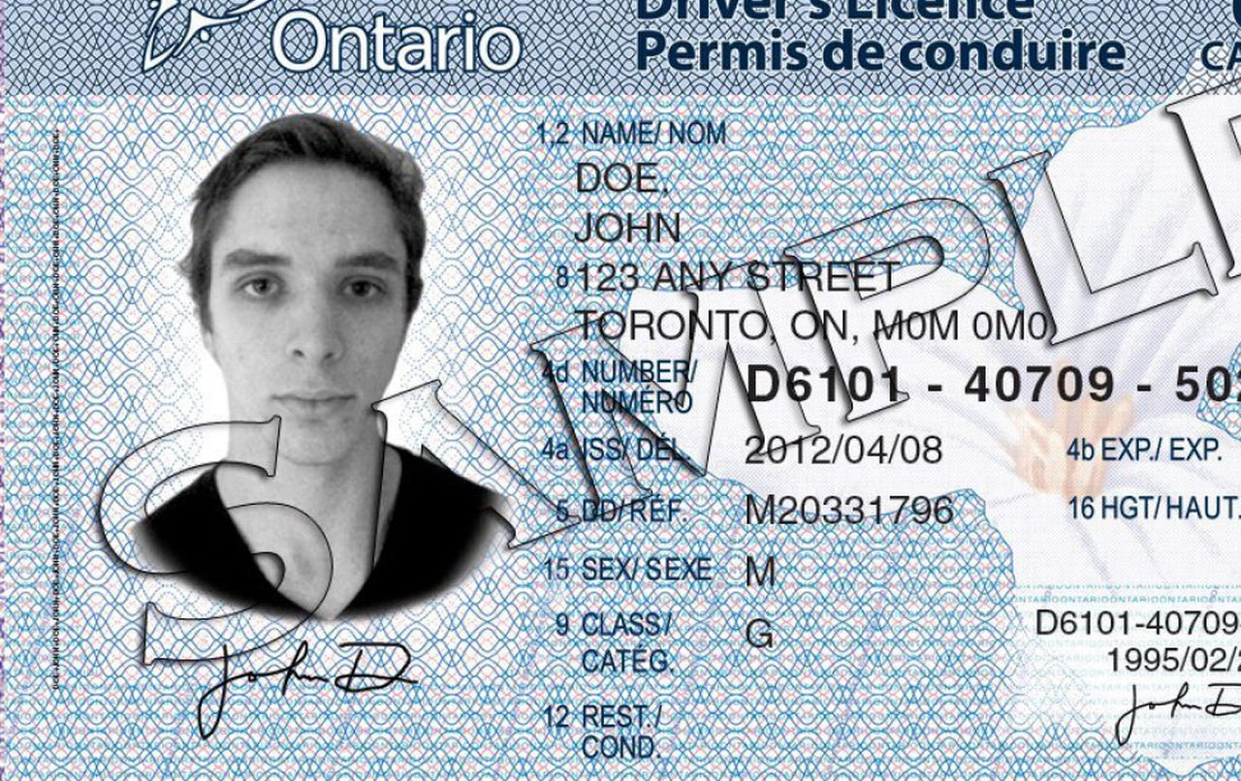
Driver’s licenses and photo cards
Other documentation
If you do not have a birth certificate or registration that represents the desired sex designation, you will need to bring the following two documents:
A letter from a licensed doctor or psychologist that is written on the doctor’s letterhead, states that the doctor has examined or treated you and they can attest that the updated designation is appropriate, and is signed by the doctor
A letter from you that includes the change you want to make, your full name and current address, your driver’s license number, and the name and address of the doctor or psychologist who has signed the other letter
Surgery is no longer required as a condition for sex designation changes. However, if you have had surgery, you are able to present documentation from a recognized specialist instead of a letter from a doctor or psychologist.

Slide 23
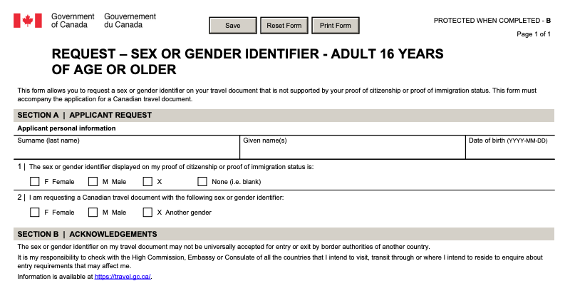
Travel documents
https://www.canada.ca/en/immigration-refugees-citizenship/services/canadian-passports/change-sex.html/
To update the sex designation on your Canadian passport, you will need to fill out the Sex or Gender Identifier Update Request Form (PPTC-643).
As with other documents, when changing your sex designation, you have the options of M (male), F (female), or X (gender neutral).
You need to provide the supporting documents when you update your sex designation:
proof of citizenship (such as a birth certificate), proof of immigration status, or a previous passport
completed sex identifier update request form
When you apply for your new travel document, you don’t need to provide the supporting documents if:
your previous passport or your verification of status document has the X marker
your proof of citizenship, proof of immigration status or previous passport has the same gender identifier

Slide 24

Travel documents
Important considerations
Unfortunately the Government of Canada states they cannot guarantee that other countries you visit or travel through will accept the sex or gender identifier on your passport or travel document, especially in regards to the X marker, and you may still be asked to provide your sex as either male or female when travelling.
Find more information at this link about travelling abroad as a 2SLGBTQI+ Canadian: https://travel.gc.ca/travelling/health-safety/lgbt-travel

Slide 25
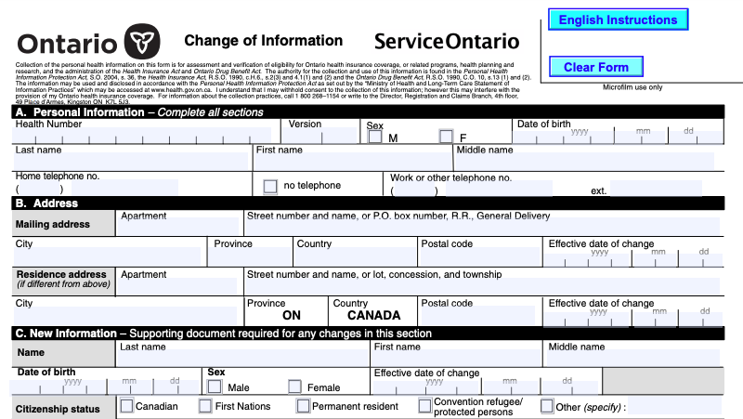
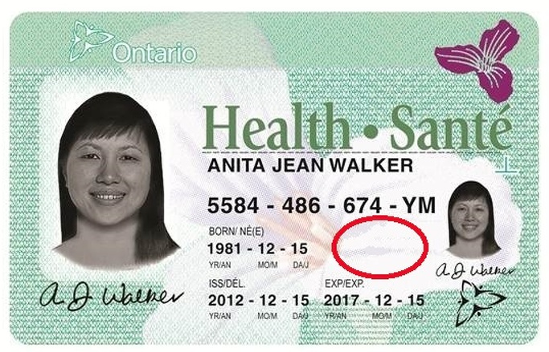
Ontario health cards
https://www.ontario.ca/page/replace-cancel-or-change-information-your-health-card#section-3
To change your name on your health card, you must visit a ServiceOntario and bring a completed Change of Information form (0280-82) as well as an original copy of one of the following documents:
Canadian birth certificate
Canadian change of name certificate
citizenship/immigration status document in the name
Sex designation is no longer listed on health cards.

Slide 26
Social Insurance Registry updates
https://www.canada.ca/en/employment-social-development/services/sin/receiving-updating.html
By law, you must update your SIN record when you change your name.
To do this you will need to submit an application either online, by mail, or in person.
There are several documents required for this process, which may vary greatly depending on your citizenship/residency. I recommend visiting the online portal for the requirement and submission guidelines: https://www.canada.ca/en/employment-social-development/services/sin/apply.html
If you are updating your sex designation, you may now choose an X marker or choose to not declare your gender. Service Canada will add a note to your record with your choice. However, please note that they have stated for the last 4+ years that until their computer systems are upgraded to register this information, "male" or "female" will still appear on your SIN record.

Slide 27
Canada Revenue Agency updates
https://www.canada.ca/en/revenue-agency/services/tax/individuals/topics/about-your-tax-return/should-you-tell-cra-about-your-change-name.html
You are currently able to update your information by phone, mail, or fax.
You will need to provide the CRA with a letter containing the following:
an original or certified true copy of one of the following documents:
- a name change certificate from a provincial/territorial vital statistics department
- a court order issued under an act on change of name
your old and new names
your social insurance number
your signature
For information on the different processes for submission via phone, or mail/fax, I recommend visiting the online portal (link above) for addresses and phone numbers relevant to your area

Slide 28
Other important updates
Once you have legally changed your name, remember to update:
Elections Canada
your electricity provider
your phone provider
your internet provider
your bank
anyone else who may possess your personal information
All these companies and registries will have different methods of updating your information, but generally require a valid Canadian Change of Name Certificate.

Slide 29
Outro and questions
Thank you once again to the CUPE 3903 Trans Feminist Action Caucus for hosting this presentation, and thank you all for attending and taking the first step in this process.
As mentioned earlier the script, slideshow, forms, and applications are currently available for download at danateagle.com/trans-id-resources.
Communities coming together to share our experiences and resources with one another is an act of resistance. I wish each and every one of you the best of luck with your applications.
Please feel free to raise your hand now in the Zoom room, or contact me privately after this presentation at dana.r.teagle@gmail.com, and I will do my best to answer any questions.

